Slide 1
Children`s challenging behaviour- WEBINAR
The webinar is part of the Erasmus+ project „Coping with students challenging behaviour“
Project no. 2019-1-EE01-KA229-051598
February 10, 2021

Slide 2
WEBINAR´S AGENDA:
Introduction of project coordinators
Introduction of project partners (schools)
An overview of the project
Questionnaires results
Methods/ approaches how to prevent and cope children´s challenging behaviour
Presentation of psychologist Marina Fjodorova
2 minutes BREAK
Psyhotherapist/psychiatrist Ilze Pelne Bērziņa
QUESTIONS TIME
Summary

Slide 3
PROJECT COORDINATORS
Petronela Ladecka from Institut for working rehabilitation for physically handicapped citizens (Slovakia), The secondary vocational school for students with physical handicaps
Marija Deletikj from “Special School D-r Zlatan Sremec” , a school for children with intellectual disabilities and autism (N.Macedonia)
Iveta Milevska from Riga Valda Avotina primary school (Latvia)
Raili Hiiesalu from Pärnu Päikese School, it is a secondary school for children with intellectual disabilities and autism (Estonia)

Slide 4
PROJECT PARTNERS
Pärnu Päikese School- coordinator of the project
Institut for working rehabilitation for physically handicapped citizens , The secondary vocational school for students with physical handicaps
Special School “D-r Zlatan Sremec” – Skopje
Riga Valda Avotina primary school

Slide 5
ABOUT THE PROJECT
Exchange of good practices;
Main priority is strengthening the profiles of the teaching professions. In general, our project will provide lasting benefits to teachers and other school specialists who work with students with disabilities;
We will try to improve teaching process in our institutions;
This improvement will be reached with the help of activities, which are focused on the topic of dealing with challenging behaviour.

Slide 6
OUR GOAL IS TO:
Share possible types of problem solving,
improve the life of pupils and teachers,
save our energy, health and wellbeing. We hope to induce lasting benefits for teachers and staff.
The direct ’’face to face’’ communication and cooperation will be effective during the transnational project meetings.
After the spread of the coronavirus, we began to find alternative ways to achieve our goals.

Slide 7
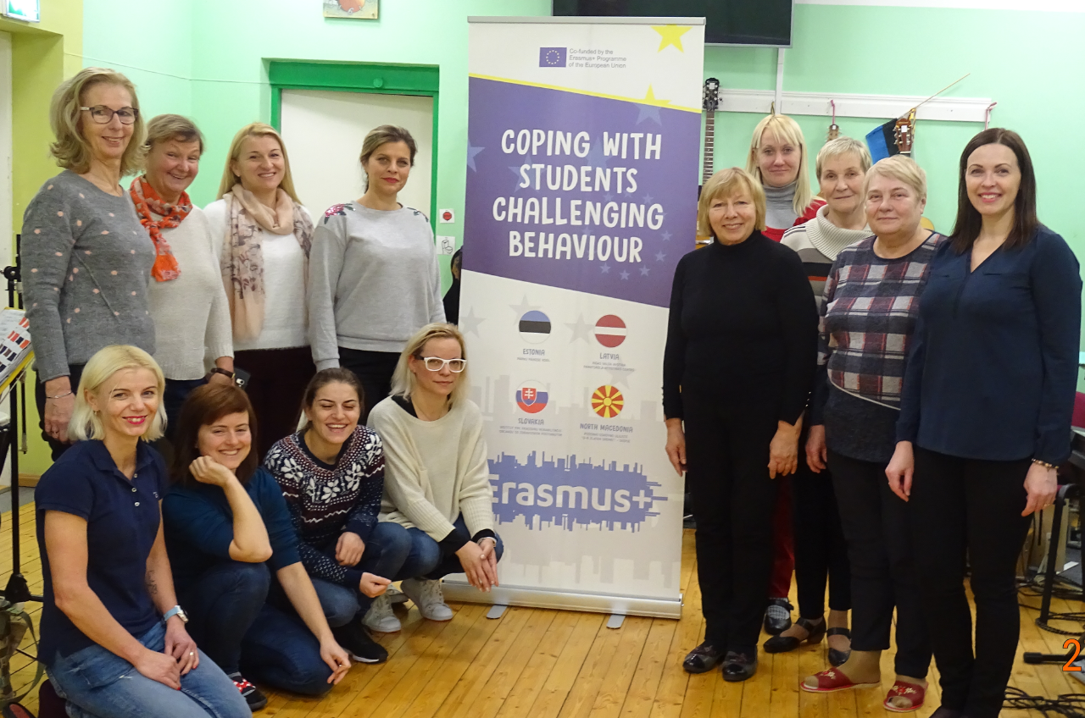
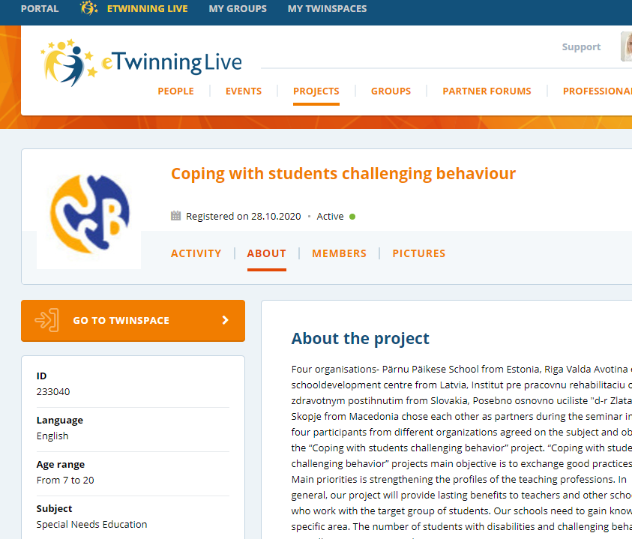
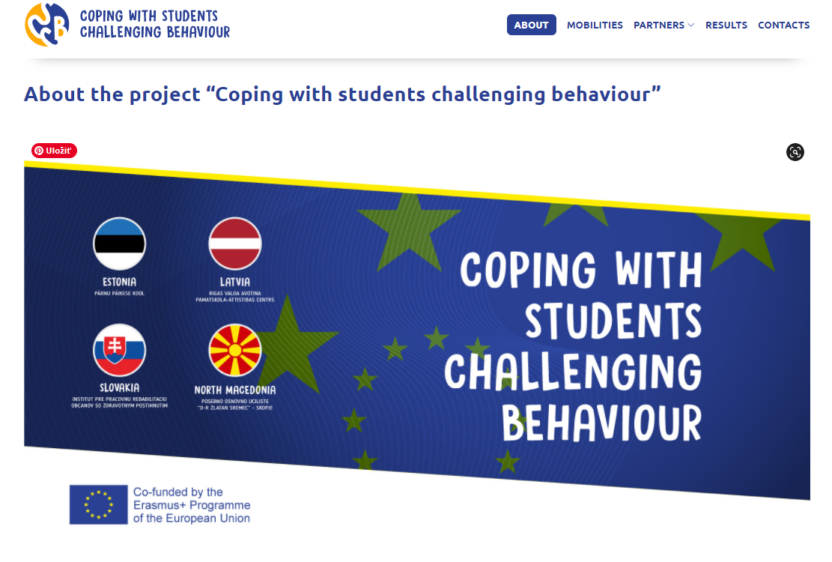
WHAT´S ALREADY DONE
C1 mobility to Estonia E-twinning project registration
Project webpage eTwinning page:

Slide 8
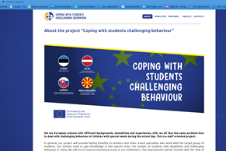
PROJECT WEB PAGE
https://cscb.parnupaike.ee/

Slide 9
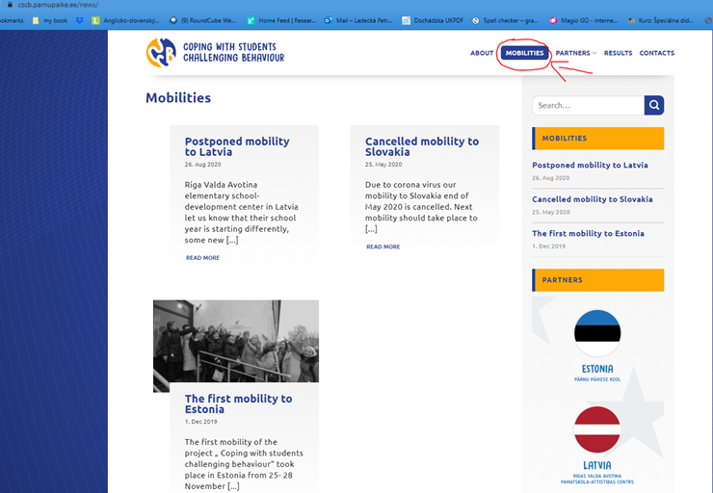

Slide 10
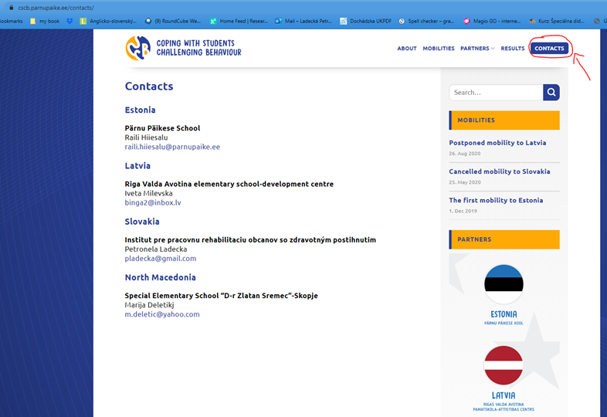

Slide 12
An international cooperation program bringing together classrooms from different schools and countries;
The main goal of eTwinning is to work together through information technology tools. The cooperation will be an educational project, the subjects, duration, results and objectives of which can be chosen by each teacher;
ETwinning offers teachers many opportunities for self-realization to learn new teaching methods together and share best practices.
Project slot in eTwinning:
https://twinspace.etwinning.net/129102/home

Slide 13
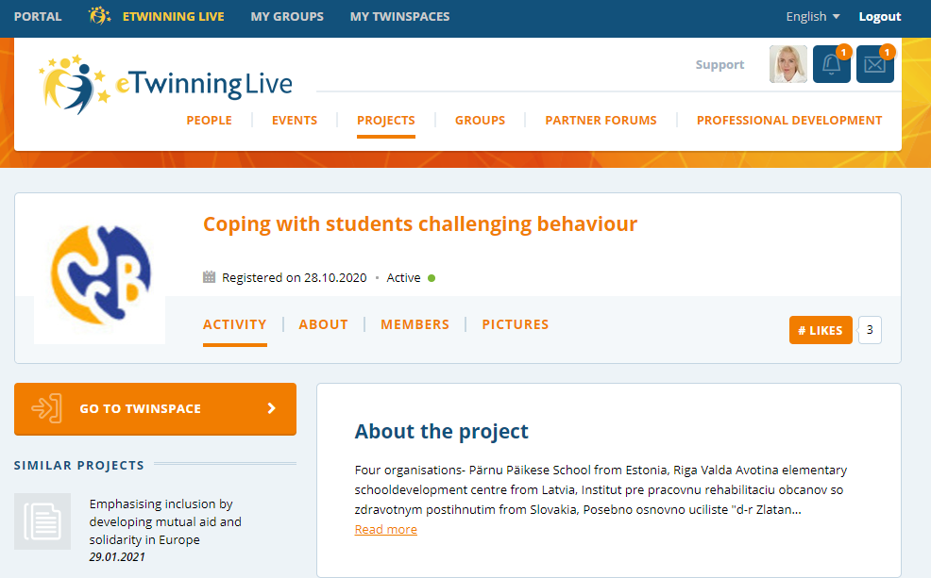

Slide 14
Why this webinar?
Spring 2020 the COVID-19
research (November 2020): What kind of help did parents get from child's teachers/school according to teaching children and dealing with challenging behaviour during COVID-19 quarantine time at home in Spring 2020.
Teachers questionnaire: useful online teaching methodology and teachers support for parents and students.

Slide 15
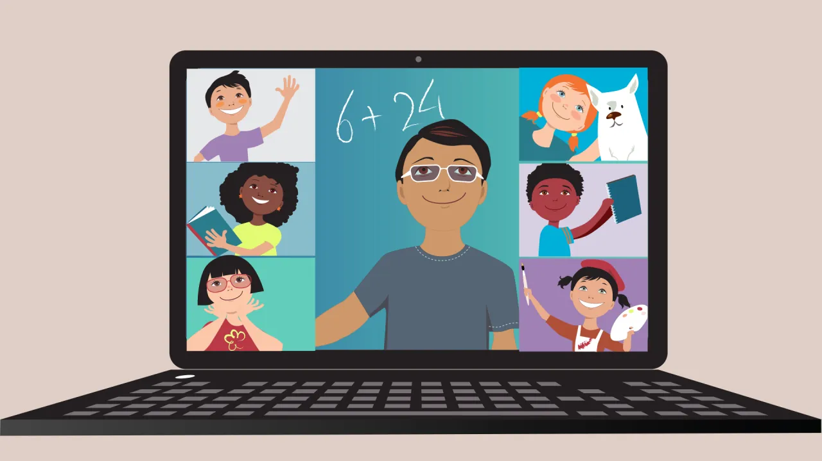
CHALLENGING BEHAVIOUR AND DISTANCE LEARNING
Overall, both parents and teachers replied that this was (Spring 2020) a difficult and hard time for them;
Stressful and tiring impact on teachers and parents;
Teachers answered that they met problem behaviour in 50% of pupils during online teaching;
Online teaching methodology and tools for SEN children are rarely available, so we can conclude that teachers were left on their own creativity, knowledge, computer competencies, capabilities etc.
Parents need at home immediate help, counselling, consulting-parent-special educator, adapted materials, psychologist visits, assistant at home for a child during distance learning, more environment exchange, consultation from teacher.

Slide 16
APPROACHES HOW TO PREVENT AND COPE WITH CHILDREN CHALLENGING BEHAVIOUR AT HOME (suggestions from Riga Valda Avotina primary school)
Developing self-esteem, empathy and respect are important teaching to manage anger and emotions;
Positive cooperation between parents and the class teacher;
Supportive daily routine;
It is very important to have good and dignified relationship with the child;
Trust the child, talk to him, prove, that he can talk about problems;
Harmonious relationship at home;

Slide 17
SUGGESTIONS FROM RIGA VALDA AVOTINA PRIMARY SCHOOL
Explain clearly what the teacher expects from the child-agree on his/her achievements, taking into account his/her abilities and state of health;
Create a safe and cosy environment at home;
Parents must not support child's unreasonably negative attitude towards teachers and school;
Parents should refrain from expressing negative attitude towards the teachers in the presence of a child, especially if he/she is an authority in his/her eyes;
Positive end of the day-conversations, playing board games,etc.

Slide 18
APPROACHES HOW TO PREVENT AND COPE WITH CHILDREN CHALLENGING BEHAVIOUR AT HOME from Institut for working rehabilitation for physically handicapped citizens (Slovakia)
Routines and rules are very important
Be active in communication
Thank for his/her effort, highlight the effort
Keep well-defined borders
Calmly asking easy questions
Motivation
Parents should keep informed and updated
Time-schedule of the days activities help students feel grounded.
SPORT

Slide 19
APPROACHES HOW TO PREVENT AND COPE WITH CHILDREN'S CHALLENGING BEHAVIOUR AT HOME (suggestions from Pärnu Päikese School from Estonia)
Collaboration between parents;
Rules and boundaries at home, discipline;
Clear and understandable communication with child;
Structure of the day, day plan;
Be there for a child;
Try to avoid irritation and tiredness due to activity;
Ensure adequate rest periods and use bonuses/rewards;

Slide 20
SUGGESTIONS from Pärnu Päikese School
Visual support- can be photographs, objects, drawins, lists;
Physical activity- regular exercise lessens anxiety;
Playing outdoors;
Plan transitions- create a predictability for transitions;
Alone corner, resting place for a child;
Predictability- predicting teaches children about cause and effect;
Be open to ask help.

Slide 21
APPROACHES HOW TO PREVENT AND COPE WITH CHILDREN CHALLENGING BEHAVIOUR AT HOME from “D-r Zlatan Sremec ” – Skopje
Identify what triggers the behaviour and how it meets your child’s needs
Keep a diary of the difficult behaviour for 1-2 weeks.
Use visual support (daily schedule for each activity during the day),
Enable communication through pictures
Reward good behavior
Respect the daily routine
Remove sources that can trigger sensory overload
Redirect the activity with visual support if that has an effect
Use short and clear instructions

Slide 22
SUGGESTIONS from SS Dr Zlatan Sremec Skopje
Avoid situations which are known to be stressful
Use a timer or a countdown to support less favoured activities
Identify signals which indicate increased levels of stress such as noises, words or actions
Be calm and compassionate. It is important that the person knows that you will be supportive
Offer suggestions as to what might make the situation better
Avoid using too much complex language
Organise a distracting activity or use some de-escalation techniques such as relaxation or vigorous physical activity
Say what you want to happen rather than commenting on the behaviour
Back off if required and make the immediate environment safe and wait until the young person is able to feel more in control

Slide 23
PRESENTATION OF PSYCHOLOGIST MARINA FJODOROVA
"Behavioural analysis as a path to behavioural changes"
1. School psychologist vs. behavioral analyst
2. Functions of behavior
3. ABC scheme of behavior
4. Environmental circumstances of challenging behavior
5. Using of different strategies for behavioral changes
6. Reinforcement and punishment
7. Summary

Slide 24
BREAK TIME

Slide 25
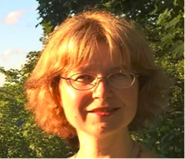
PSYCHOTHERAPIST/ PSYCHIATRIST
Ilze Pelne Bērziņa
"Challenging behaviour at school from psychotherapist's/psychiatrist's point of view"

Slide 26
QUESTIONS- please write in chat window

Slide 27
Thank you for attending!
Contacts
PETRONELA LADECKA (Slovakia)
email: pladecka@gmail.com
IVETA MILEVSKA (Latvia)
email: binga2@inbox.lv
MARIJA DELETIKJ (Macedonia)
email: m.deletic@yahoo.com
RAILI HIIESALU (Estonia)
email: raili.hiiesalu@gmail.com

Slide 28
DISCLAMER
"The European Commission support for the production of this publication does not constitute an endorsement of the contents which reflects the views only of the authors, and the Commission cannot be held responsible for any use which may be made of the information contained therein."

